Slide 1
National Recreational Boating Safety Survey
2026 PTC Colab
October 15, 2026
Lindsey Witt-Swanson

Slide 2
Background
The National Recreational Boating Safety Survey (NRBSS)

Slide 3
National Recreational Boating Safety Survey
The National Recreational Boating Safety Survey (NRBSS) has been conducted periodically since 1974.
Provides publicly available data
Paddlecraft ownership
Paddlecraft use
Safety practices of paddlers
Characteristics of paddlers
Supports the 2022 – 2026 Strategic Plan of the National Recreational Boating Safety Program
The NRBSS comprises two surveys: Participation and Exposure
Notes:
Exposure providing state-level estimates and Participation providing results at the Census region

Slide 4
National Recreational Boating Safety Survey
Exposure Survey Goals
Produce reliable boating exposure estimates and risk ratios
Number of boats owned and number of boats operated on the water
Number of days and hours boats were operated and number of persons aboard these boats when operated
Produce estimates that can be compared across:
States
Different types of boats
  Produce estimates at both the household level and boat level

Slide 5
National Recreational Boating Safety Survey
Participation Survey Goals
Generate a demographic profile of boating participants
Generate estimates at the household level and individual level
Produce estimates of boating frequency by demographic groups
Understand changes in boating participant characteristics over time
Understand the types of activities engaged in by type of boat
Estimates derived from the Participation Survey will be provided at the Census region level.

Slide 6
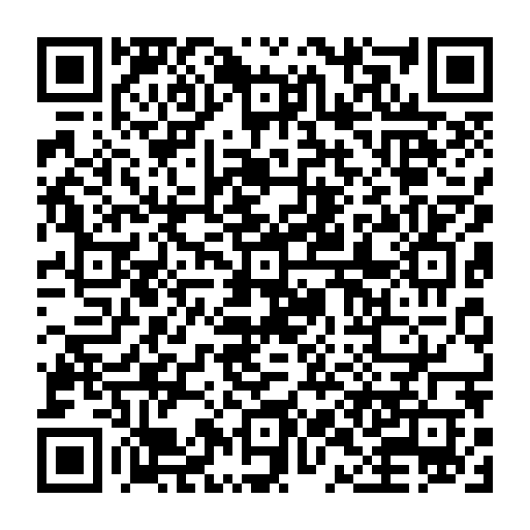
National Recreational Boating Safety Survey
The data are used in many ways by various data users.
Reports available on www.uscgboating.org and storyboard
Estimate the total number of boaters in the U.S. and their demographics.
Analyze the population and usage patterns of unregistered boats, including paddlecraft.
Estimate the average time spent boating (exposure hours)
Identify trends in marine safety and the use of safety equipment.
Examine trends in boating safety education and awareness.

Slide 7
2018 Paddlecraft Results
Exposure Survey

Slide 8
National Recreational Boating Safety Survey
Paddlecraft findings from the 2018 Exposure Survey
A median 1-2 people were aboard paddlecraft when out on the water
33.14 million people engaged in paddling canoes, kayaks, paddleboards, and inflatables
Americans spent 228,475 days on paddlecraft vs. 977,403 days on motorized boats

Slide 9
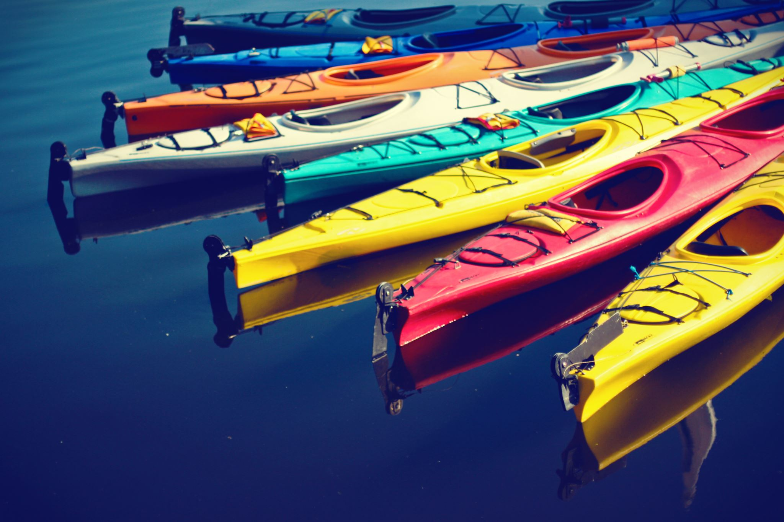
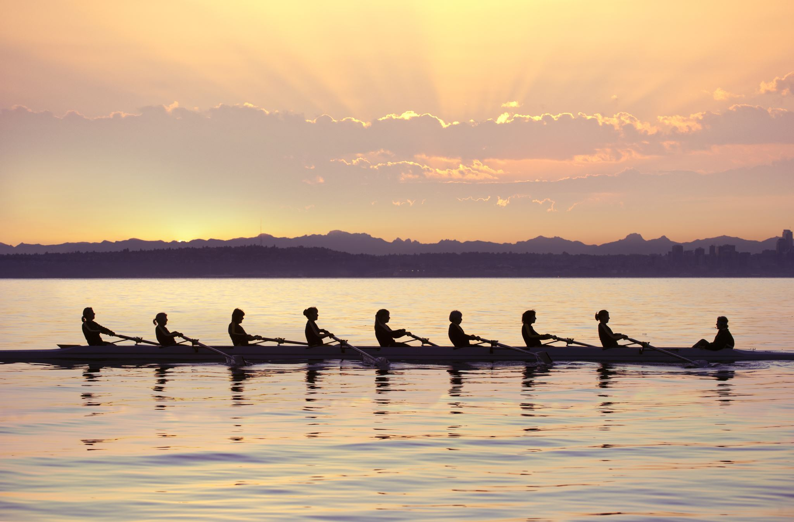


National Recreational Boating Safety Survey
Kayaks were the most popular paddlecraft to own in 2018
Kayaks
Rowed Boats
Canoes
Paddleboards
3.5%
1.3%
1.8%
0.5%
of all U.S. households
of all U.S. households
of all U.S. households
of all U.S. households
29.3%
16.4%
14.7%
4.6%
of all boating households
of all boating households
of all boating households
of all boating households
7,556,000
2,540,000
2,422,000
807,000
total
total
total
total

Slide 10
National Recreational Boating Safety Survey
Paddleboards are more common in the South and West while row boats are less common in the Northeast
Notes:
Table 3-8. Number and Percentage of Recreational Boats Owned by U.S. Households by Boat Type and by Census Region of Registration or Storage, 2018 page 42

Slide 11
National Recreational Boating Safety Survey
Paddlecraft are more popular in the Northeast and West and less popular in the South and Midwest
Notes:
Table 3-33. Number and Percentage of Boat Outings by Aggregated Boat Type by Census Region of Operation page 73

Slide 12
National Recreational Boating Safety Survey
Most paddlecraft are stored on land
Notes:
Table 3-20. Locations Where Operated Boats Were Stored in the U.S. by Boat Type, 2018 page 56

Slide 13
National Recreational Boating Safety Survey
In 2026, did you or any member of your household own, rent, or borrow…?
an open motorboat, such as a bass boat, center console boat, or ski boat
a cabin motorboat
a pontoon boat
an air boat
a houseboat
an auxiliary sailboat (sailboat with motor)
a sailboat (powered by sail only)
a personal watercraft, such as a WaveRunner™, Jetski™, Sea-Doo™
a rowboat, such as a shell, scull, or skiff, including inflatables, such as a raft
a canoe, including an inflatable canoe
a kayak, including an inflatable kayak
a standup paddleboard (SUP), including an inflatable SUP
some other type of paddlecraft (not including canoes, kayaks, or standup paddleboards (SUPs))
a mechanically propelled hydrofoil or surfboard, also known as an eFoil or Jetboard
another type of recreational boat or watercraft not previously listed, not including an inflatable tube or inner tube

Slide 14
National Recreational Boating Safety Survey
In which of the following activities did you or the people aboard the [VESSEL] participate during that outing in [MONTH & YEAR]? Please select all that apply.
Fishing or crabbing
Towed watersports such as waterskiing, wakeboarding, or tubing
Hunting from the boat
Racing
Scuba diving or snorkeling off or from the boat
Sightseeing
Wildlife viewing, birdwatching, or observing nature
Socializing with friends/family
Sunbathing
Swimming off or from the boat
Traveling to a restaurant
Consuming alcohol
Other activities while out on the water
Don’t know

Slide 15
Anticipated Paddlecraft Data
Participation Survey

Slide 16
National Recreational Boating Safety Survey
Anticipated Findings from the 2026 Participation Survey
Demographic characteristics of paddlers by type of paddlecraft
Age, Sex, Race, Education, Employment Status, Household income
Activities participated in while on paddlecraft
Paddlecraft purchasing behavior during the COVID pandemic

Slide 17
National Recreational Boating Safety Survey
From [P_DATERANGE_INSERT], did anyone in your household go out on the water on any of the following boats?
an open motorboat, such as a bass boat, center console boat, or ski boat
a cabin motorboat
a pontoon boat
an air boat
a houseboat
an auxiliary sailboat (sailboat with motor)
a sailboat (powered by sail only)
a personal watercraft, such as a WaveRunner™, Jetski™, Sea-Doo™
a rowboat, such as a shell, scull, or skiff, including inflatables, such as a raft
a canoe, including an inflatable canoe
a kayak, including an inflatable kayak
a standup paddleboard (SUP), including an inflatable SUP
some other type of paddlecraft (not including canoes, kayaks, or standup paddleboards (SUPs))
a mechanically propelled hydrofoil or surfboard, also known as an eFoil or Jetboard
another type of recreational boat or watercraft not previously listed, not including an inflatable tube or inner tube

Slide 18
National Recreational Boating Safety Survey
In which of the following activities did you or the people aboard the [VESSEL] participate during that outing in [MONTH & YEAR]? Please select all that apply.
Fishing or crabbing
Towed watersports such as waterskiing, wakeboarding, or tubing
Hunting from the boat
Racing
Scuba diving or snorkeling off or from the boat
Sightseeing
Wildlife viewing, birdwatching, or observing nature
Socializing with friends/family
Sunbathing
Swimming off or from the boat
Traveling to a restaurant
Consuming alcohol
Other activities while out on the water
Don’t know

Slide 19
National Recreational Boating Safety Survey
Other questions of potential interest
What percentage of your outings occur at night?
What percentage of your outings occur in cold waters, that is, water below 60 degrees Fahrenheit or 15 degrees Celsius?
How frequently, if at all, do you let others know that you’re going out on the water in case of an emergency?
How do you let others know that you’re going out on the water in case of an emergency?
If, how, and when took a safety course

Slide 20
How You Can Stay Involved

Slide 21
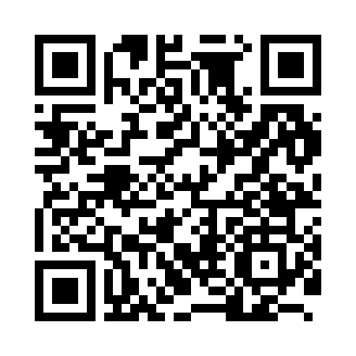
National Recreational Boating Safety Survey
Help make the survey more representative of paddlers
Volunteer!
  https://tinyurl.com/2fab2zsn
Share through listserv
Social Media Followers

Slide 22
Timeline

Slide 23
National Recreational Boating Safety Survey
NRBSS Timeline: 2026
Conduct data collection
Process and evaluate data
Begin analyzing data and prepare preliminary results

Slide 24
National Recreational Boating Safety Survey
NRBSS Timeline: 2027
Complete data collection
Finalize data
Produce the final report and other deliverables
Disseminate the report

Slide 25
Questions?

Slide 26
Thank you.
Lindsey Witt-Swanson
  Senior Research Director
  Witt-swanson-lindsey@norc.org

