Slide 1
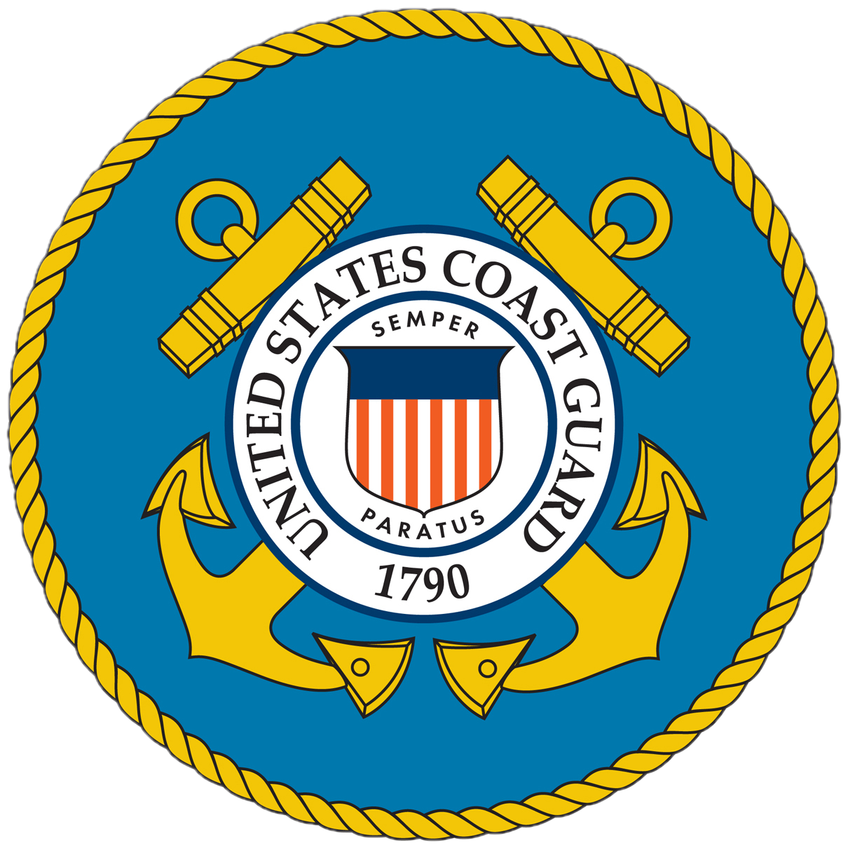


Recreational Boating Safety -
INFLUENCE BOATERS’BEHAVIORS
PTC COLAB 2026
Scott Szczepaniak
Southeast District Recreational Boating Program Specialist

Slide 2

OBJECTIVES
Background on Coast Guard’s role in boating safety including statistical collection
Trends in fatalities, specific to paddlecraft
3. Safety interventions = casual to committed paddlers

Slide 3
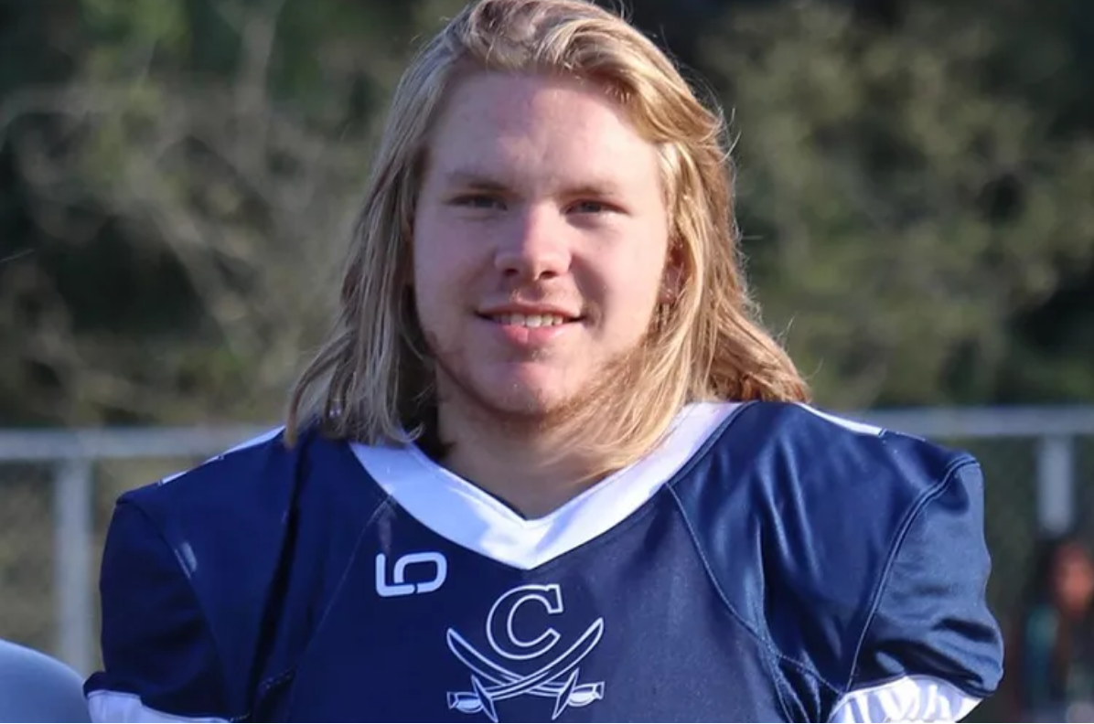
WHY?
19 YEAR OLD JOSH EDWARDS
Notes:
20 YARDS FROM SHORE. 10’ OF WATER. NO PFD. AUGUST 17TH, 2024. MOM OF DIVER WHO RECOVERED HIM IN MY KAYAK 101 CLASS STARTED CRYING WHEN I TOLD THE STORY. SO TYPICAL OF PADDLER DEATHS!

Slide 4
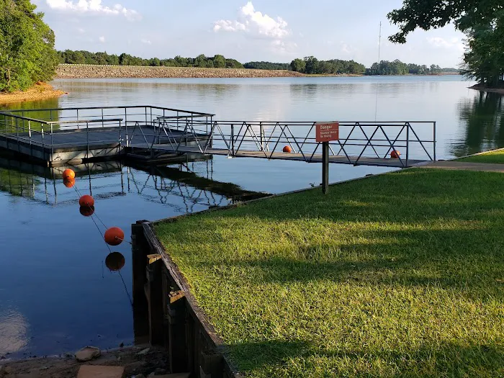
SINGING PINES RECREATION AREA LAKE HARTWELL, SOUTH CAROLINA
Notes:
20 YARDS FROM SHORE. 10’ OF WATER. NO PFD. AUGUST 17TH, 2024. MOM OF DIVER WHO RECOVERED HIM IN MY KAYAK 101 CLASS STARTED CRYING WHEN I TOLD THE STORY. TYPICAL OF PADDLING DEATHS… MALE, TEENS TO 20S, INEXPERIENCED, “EASY WATER”

Slide 5
Mission of Recreational Boating Safety Program
“… reduce fatalities, injuries
and property damage…”

Slide 6
HOW?
Strategic plan directs us to
“…influence boaters’ (paddlers’) behaviors…”

Slide 7

HQ Program Division
BOATING SAFETY DIVISION (CG-BSX-2)
Part of Prevention
RECREATIONAL BOATING SAFETY IN D7 - PREVENTION THRU PARTNERSHIPS!
Notes:
WE’LL TALK MORE ABOUT THEM IN A BIT

Slide 8
RECREATIONAL BOATING INCIDENT
INVESTIGATION AND REPORTING

Slide 9
INCIDENT INVESTIGATIONS
State boating agencies investigate fatalities and other recreational boating accidents / incidents

Slide 10
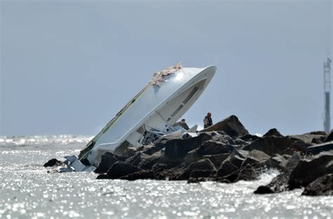
REPORTABLE INCIDENTS
Fatality
Presumption of Fatality
Injury beyond First Aid
Damage over $2,000
Total loss of vessel

Slide 11
2025 Recreational Boating Statistics Executive Summary
Preliminary - target date for publication Oct 31, 2026
NOTE: ALL RECREATIONAL BOATS INCLUDING PADDLECRAFT AND HUMAN POWERED CRAFT
…In calendar year 2025, the Coast Guard verified 3,890 incidents that involved 568 deaths, 2,119 injuries and approximately $89 million of damage to property as a result of recreational boating incidents reportable under 33 CFR 173….

Slide 12
2025 Recreational Boating Statistics Executive Summary
“…the most recent three years, boating fatalities reached their lowest cumulative level since the program began keeping records in 1962.”

Slide 13
However…

Slide 14
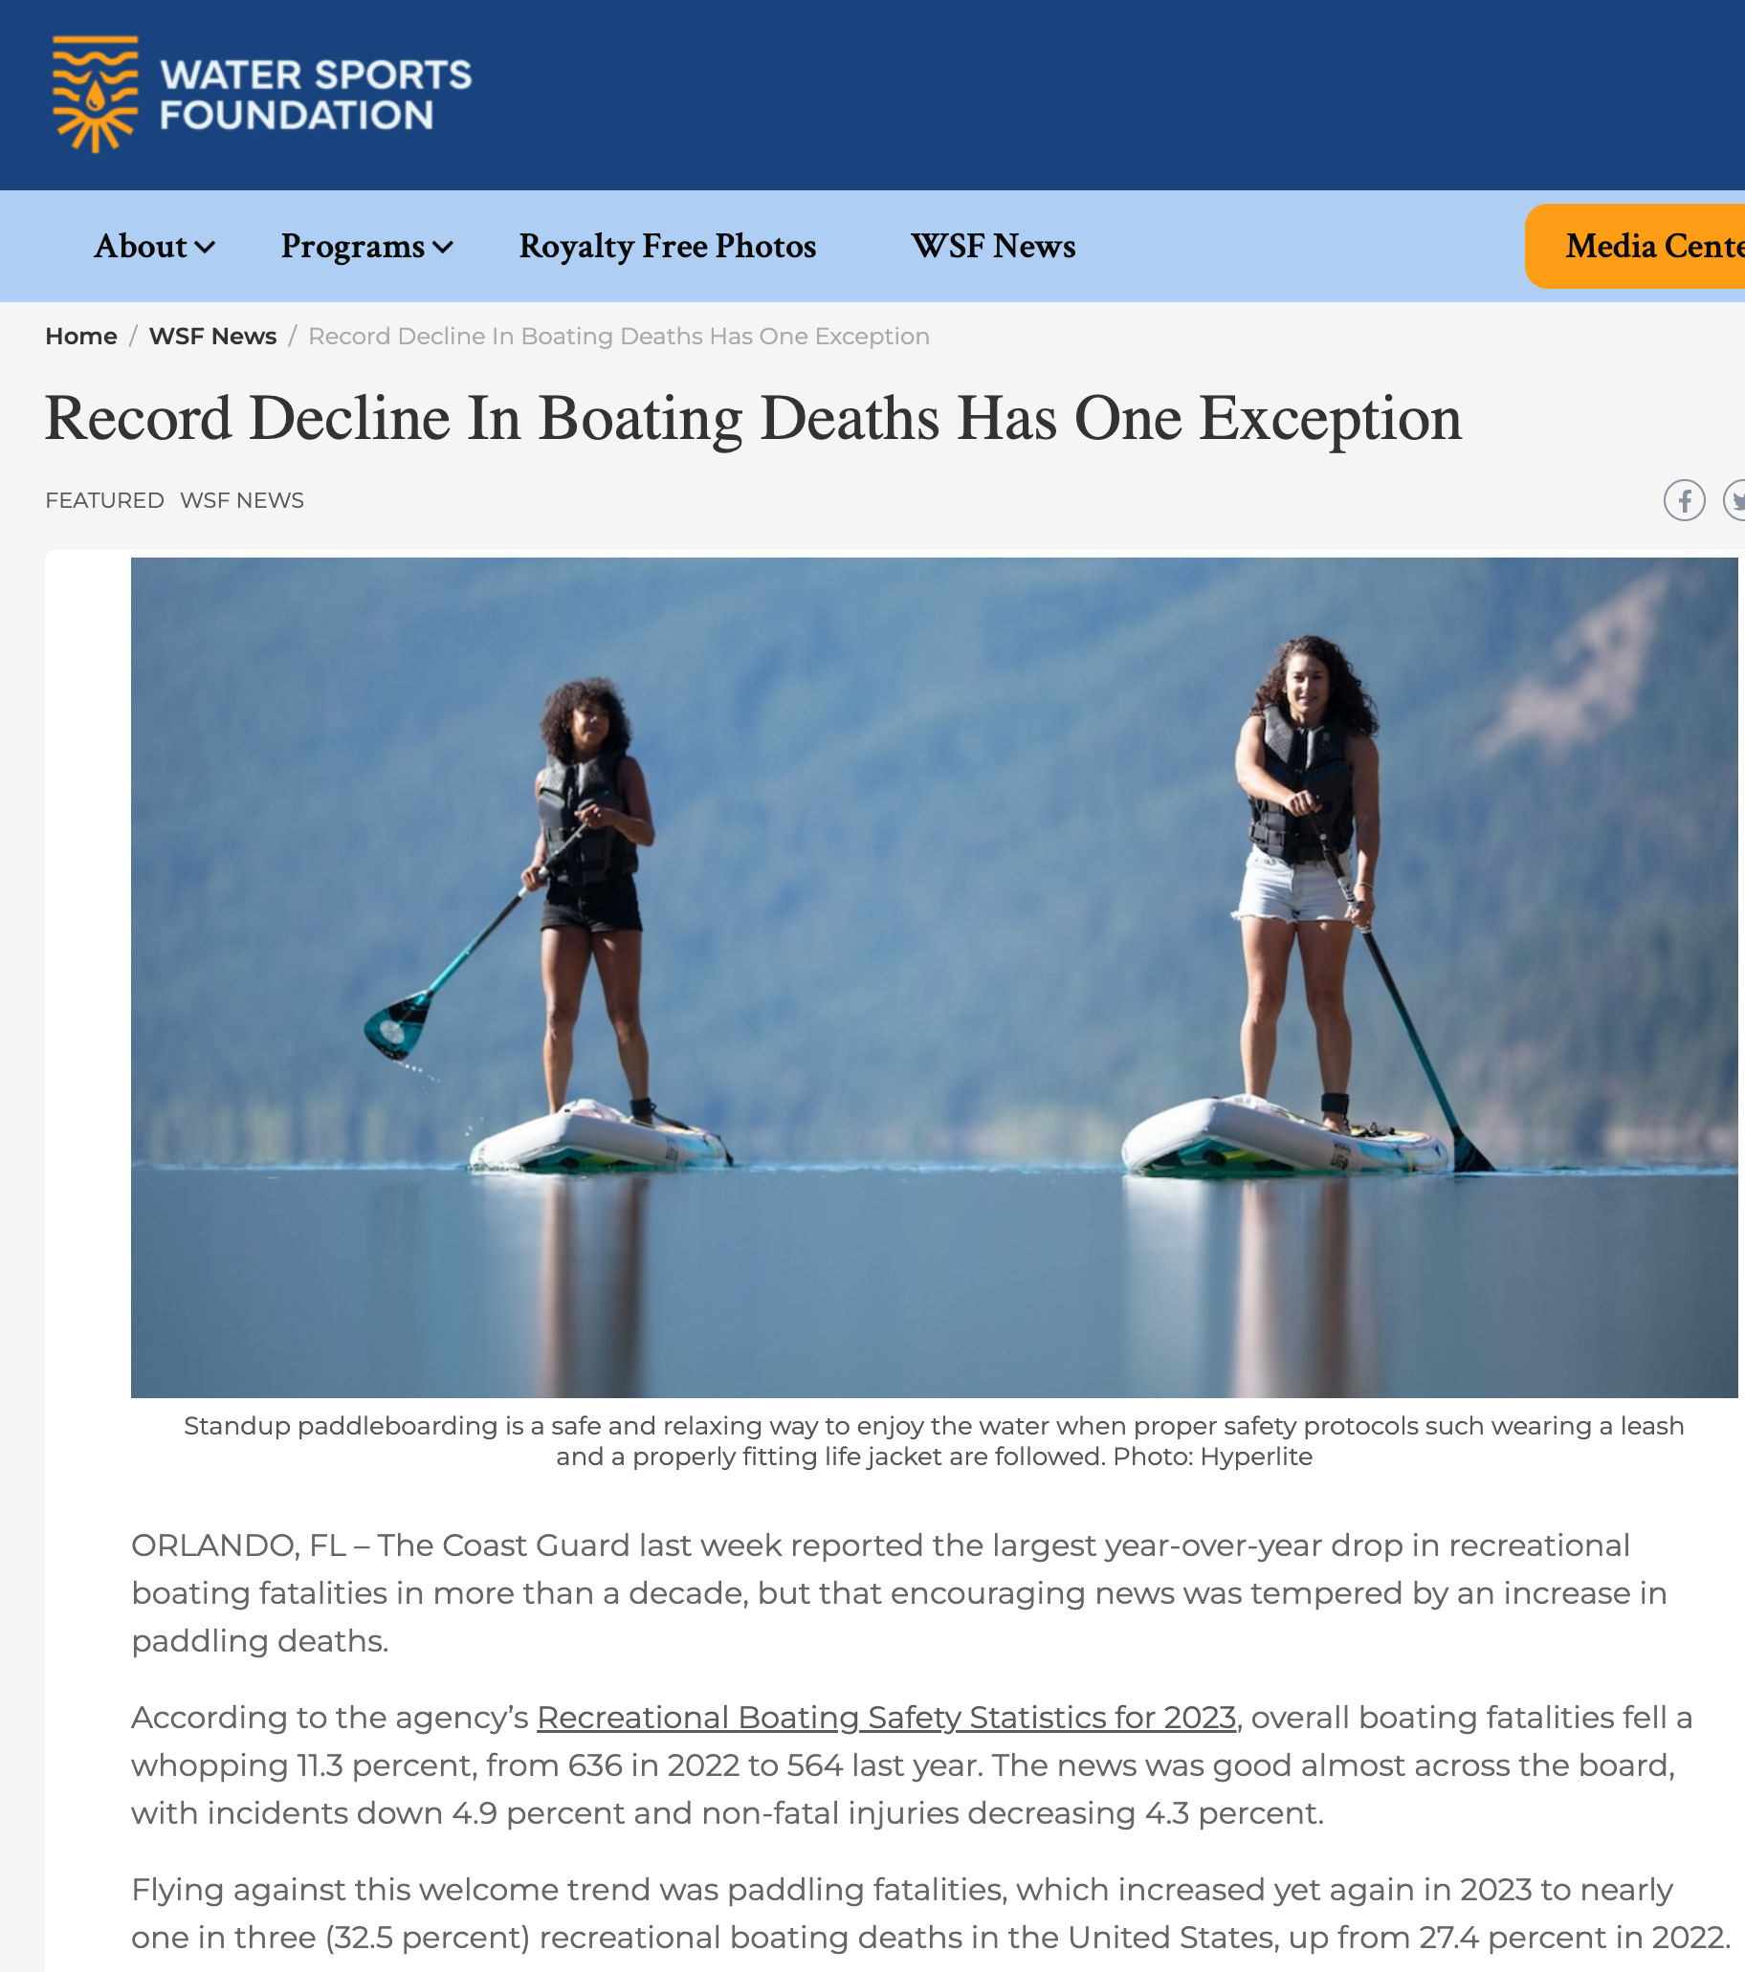

Slide 15
National Human Powered Craft Fatalities
 | TOTAL RECREATIONAL BOATING FATALITIES | Kayak | Canoe | SUP
2023 | 564 | 95 — 17% | 43 — 8% | 11 — 2%
2024 | 556 | 89 — 16% | 25 — 4.5% | 28 — 5%
2025 | 568 | 90 — 16% | 28 — 5% | 23 —4%
Notes:
149, 142, 141

Slide 16
1 PADDLER DEATH =
HUNDREDS OF PEOPLES LIVES FOREVER IMPACTED

Slide 17
INFORMATION AND DATA DOESN’T
CHANGE PEOPLES BEHAVIORS,
STORIES DO!

Slide 18
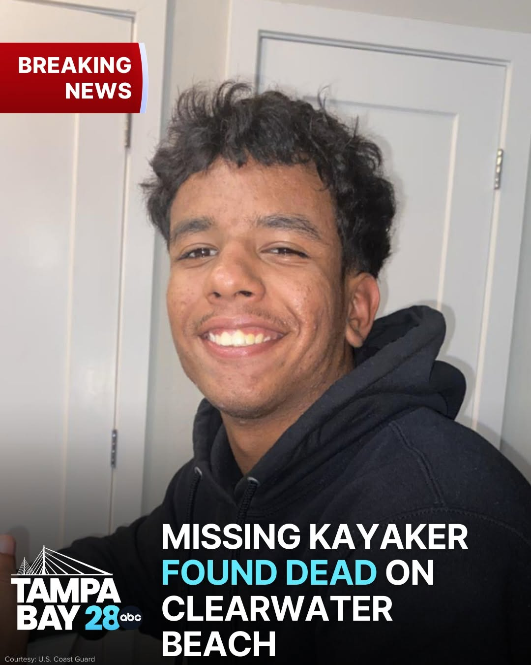
Elias Guillermo Lara Vargas
18 years old

Slide 19
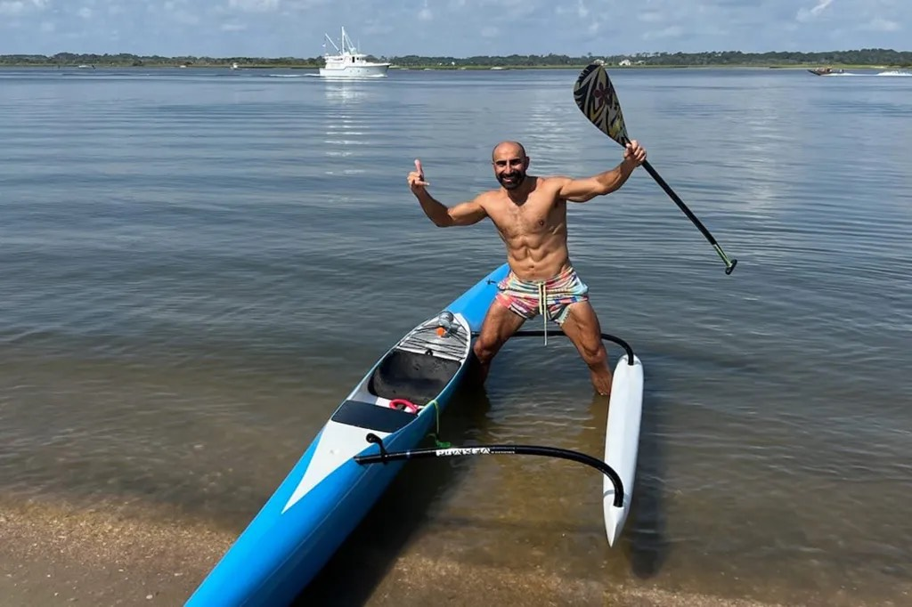
Notes:
December 2023 death of 46-year-old fitness director Eiffel Gilyana, who vanished while paddling off Vilano Beach.

Slide 20
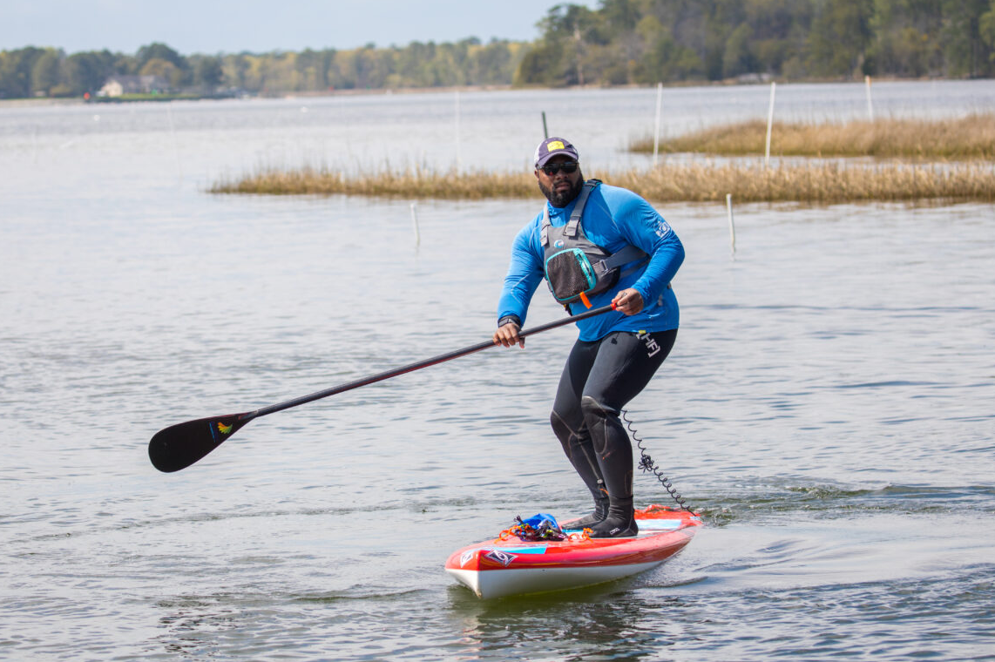
STANDUP PADDLEBOARDS aka SUPs

Slide 21
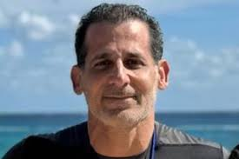
DR. ZIAD ABDEEN
49 YOM
ICW DUNEDIN, FL
FEB 2024
NO PFD
STANDUP PADDLEBOARDS / SUPs

Slide 22
INITIATIVES
TO INFLUENCE PADDLERS BEHAVIORS
AND REDUCE FATALITIES

Slide 23
BIG 5 (INTERVENTIONS)
1. WEAR A LIFE JACKET
2. TAKE A CLASS
3. PADDLE IN GROUPS OF 3 (BOATS) OR MORE
4. RESPECT WEATHER AND COLD WATER
5. PADDLE SOBER
Notes:
Based on Dr. Robin Pope’s “evidence based analysis”

Slide 24

COAST GUARD AUXILIARY PADDLECRAFT SAFETY
WHY?
1 IN 3 BOATING FATALITIES
INVOLVE PADDLECRAFT: KAYAKS, CANOES,
STAND UP PADDLEBOARDS, INFLATABLES AND ROWBOATS
CGD-SE RBS - PREVENTION THROUGH PARTNERSHIPS

Slide 25
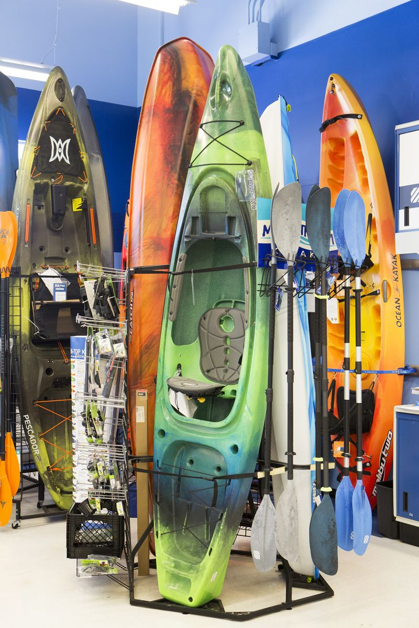
EASY TO GRASP, LOW HANGING FRUIT!
ENCOURAGE LIFE JACKET WEAR
NEW PADDLERS JUST DON’T KNOW
Notes:
HEY, COOL NEW KAYAKS! WHERE DID YOU GET THEM? WHERE YOU HEADED? I CHECKED THE WEATHER FORECAST AND WEATHER RADAR ON MY GIZMO. CLEAR FOR NOW - FORECAST HAS T-STORM LATE THIS AFTERNOON. HEY I DON’T WANT TO BE A BUSYBODY BUT… I SEE YOU DON’T HAVE LIFE JACKETS. I’M A MEMBER OF THE COAST GUARD AUXILIARY. WE DON’T ENFORCE, BUT FWC AND ACTIVE DUTY FOLKS WILL TERMINATE YOU, AND WRITE YOU A FINE. THERE IS A LIFE JACKET LOANER STATION OVER BY THE MAIN RAMP. THEY ONLY REALLY WORK IF YOU WEAR THEM. WEB SEARCH ON KAYAK LIFEJACKETS

Slide 26
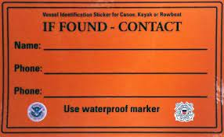
PADDLECRAFT SAFETY
Reduce unnecessary SAR
Clean surface of kayak, etc.
Inspect each trip
Glossy finish problematic
D7 RBS - PREVENTION THRU PARTNERSHIPS!
Notes:
WHERE TO OBTAIN?

Slide 27
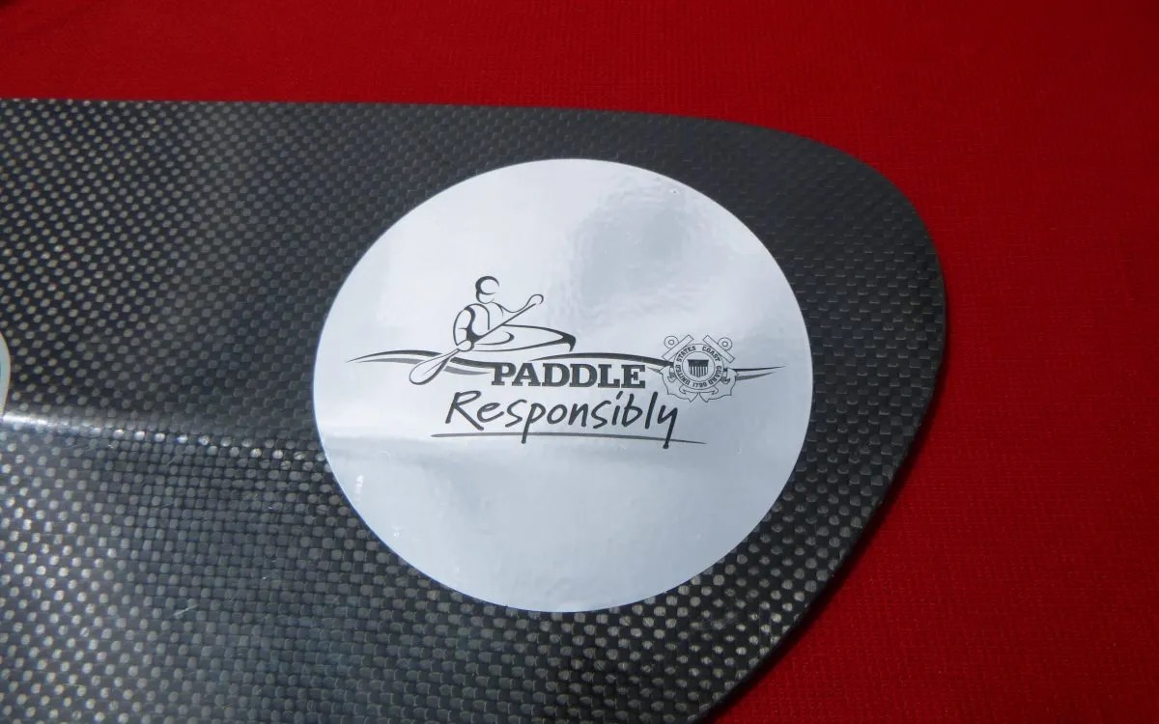
PADDLE TIP REFLECTOR KITS - IT’S NOT ABOUT
INCREASED VISIBILITY…
Notes:
OOOH, SHINY! A TICKET TO ENCOURAGE LIFE JACKET WEAR.

Slide 28

Auxiliary Paddlecraft Safety
Reduce fatalities by:
Encouraging life jacket wear
Weather awareness
Cold water awareness
Float Plans
D7 Coordinator Aux Charles Hayes

Slide 29
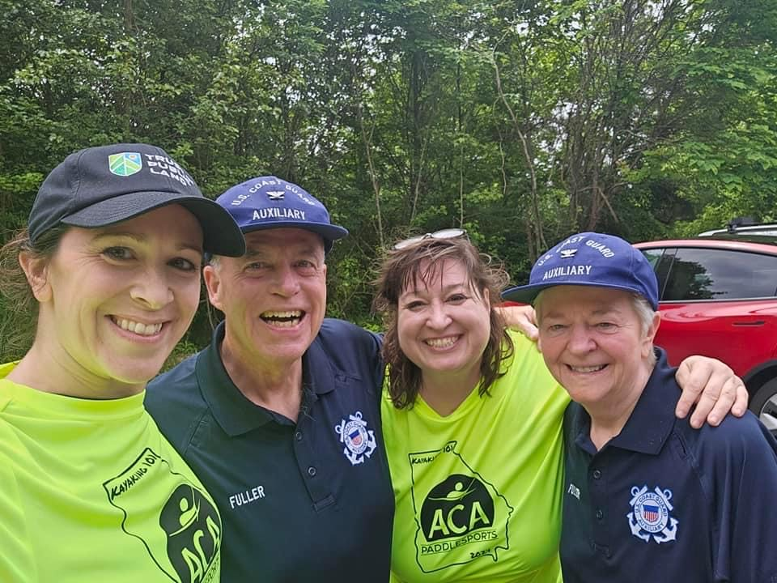
KAYAK 101

Slide 30
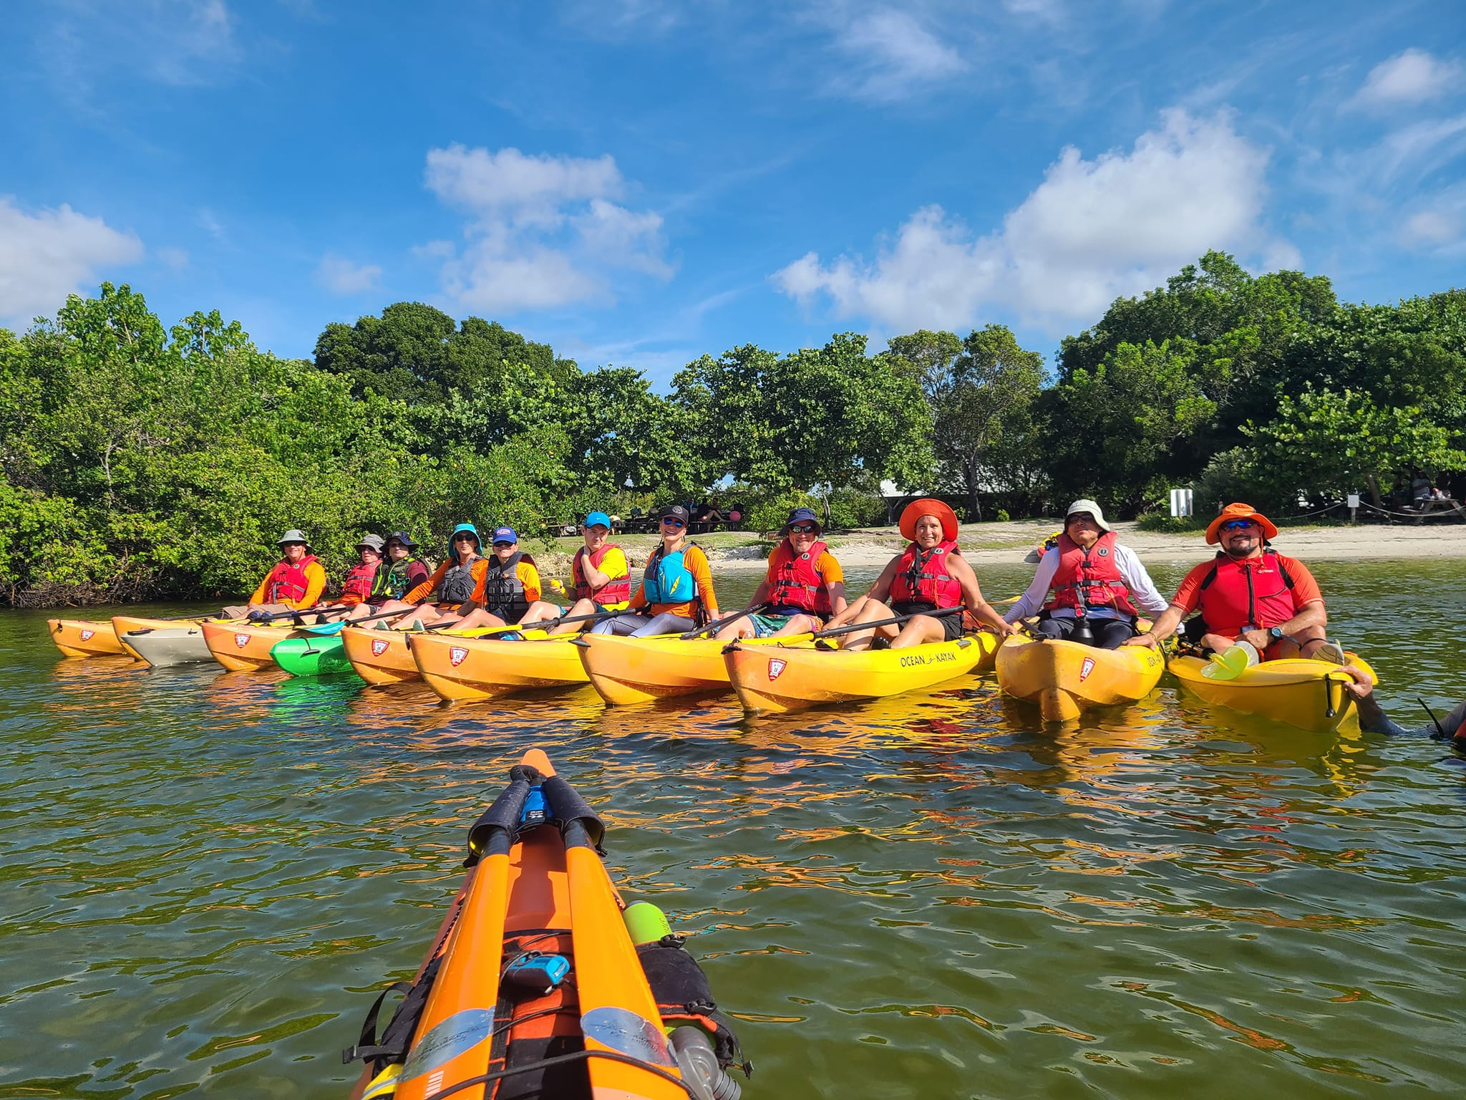
SPRING AUXPAD TRAINING
NATIONAL TRAINING IN CHARLESTON, SC NEXT IN APRIL 2027

Slide 31
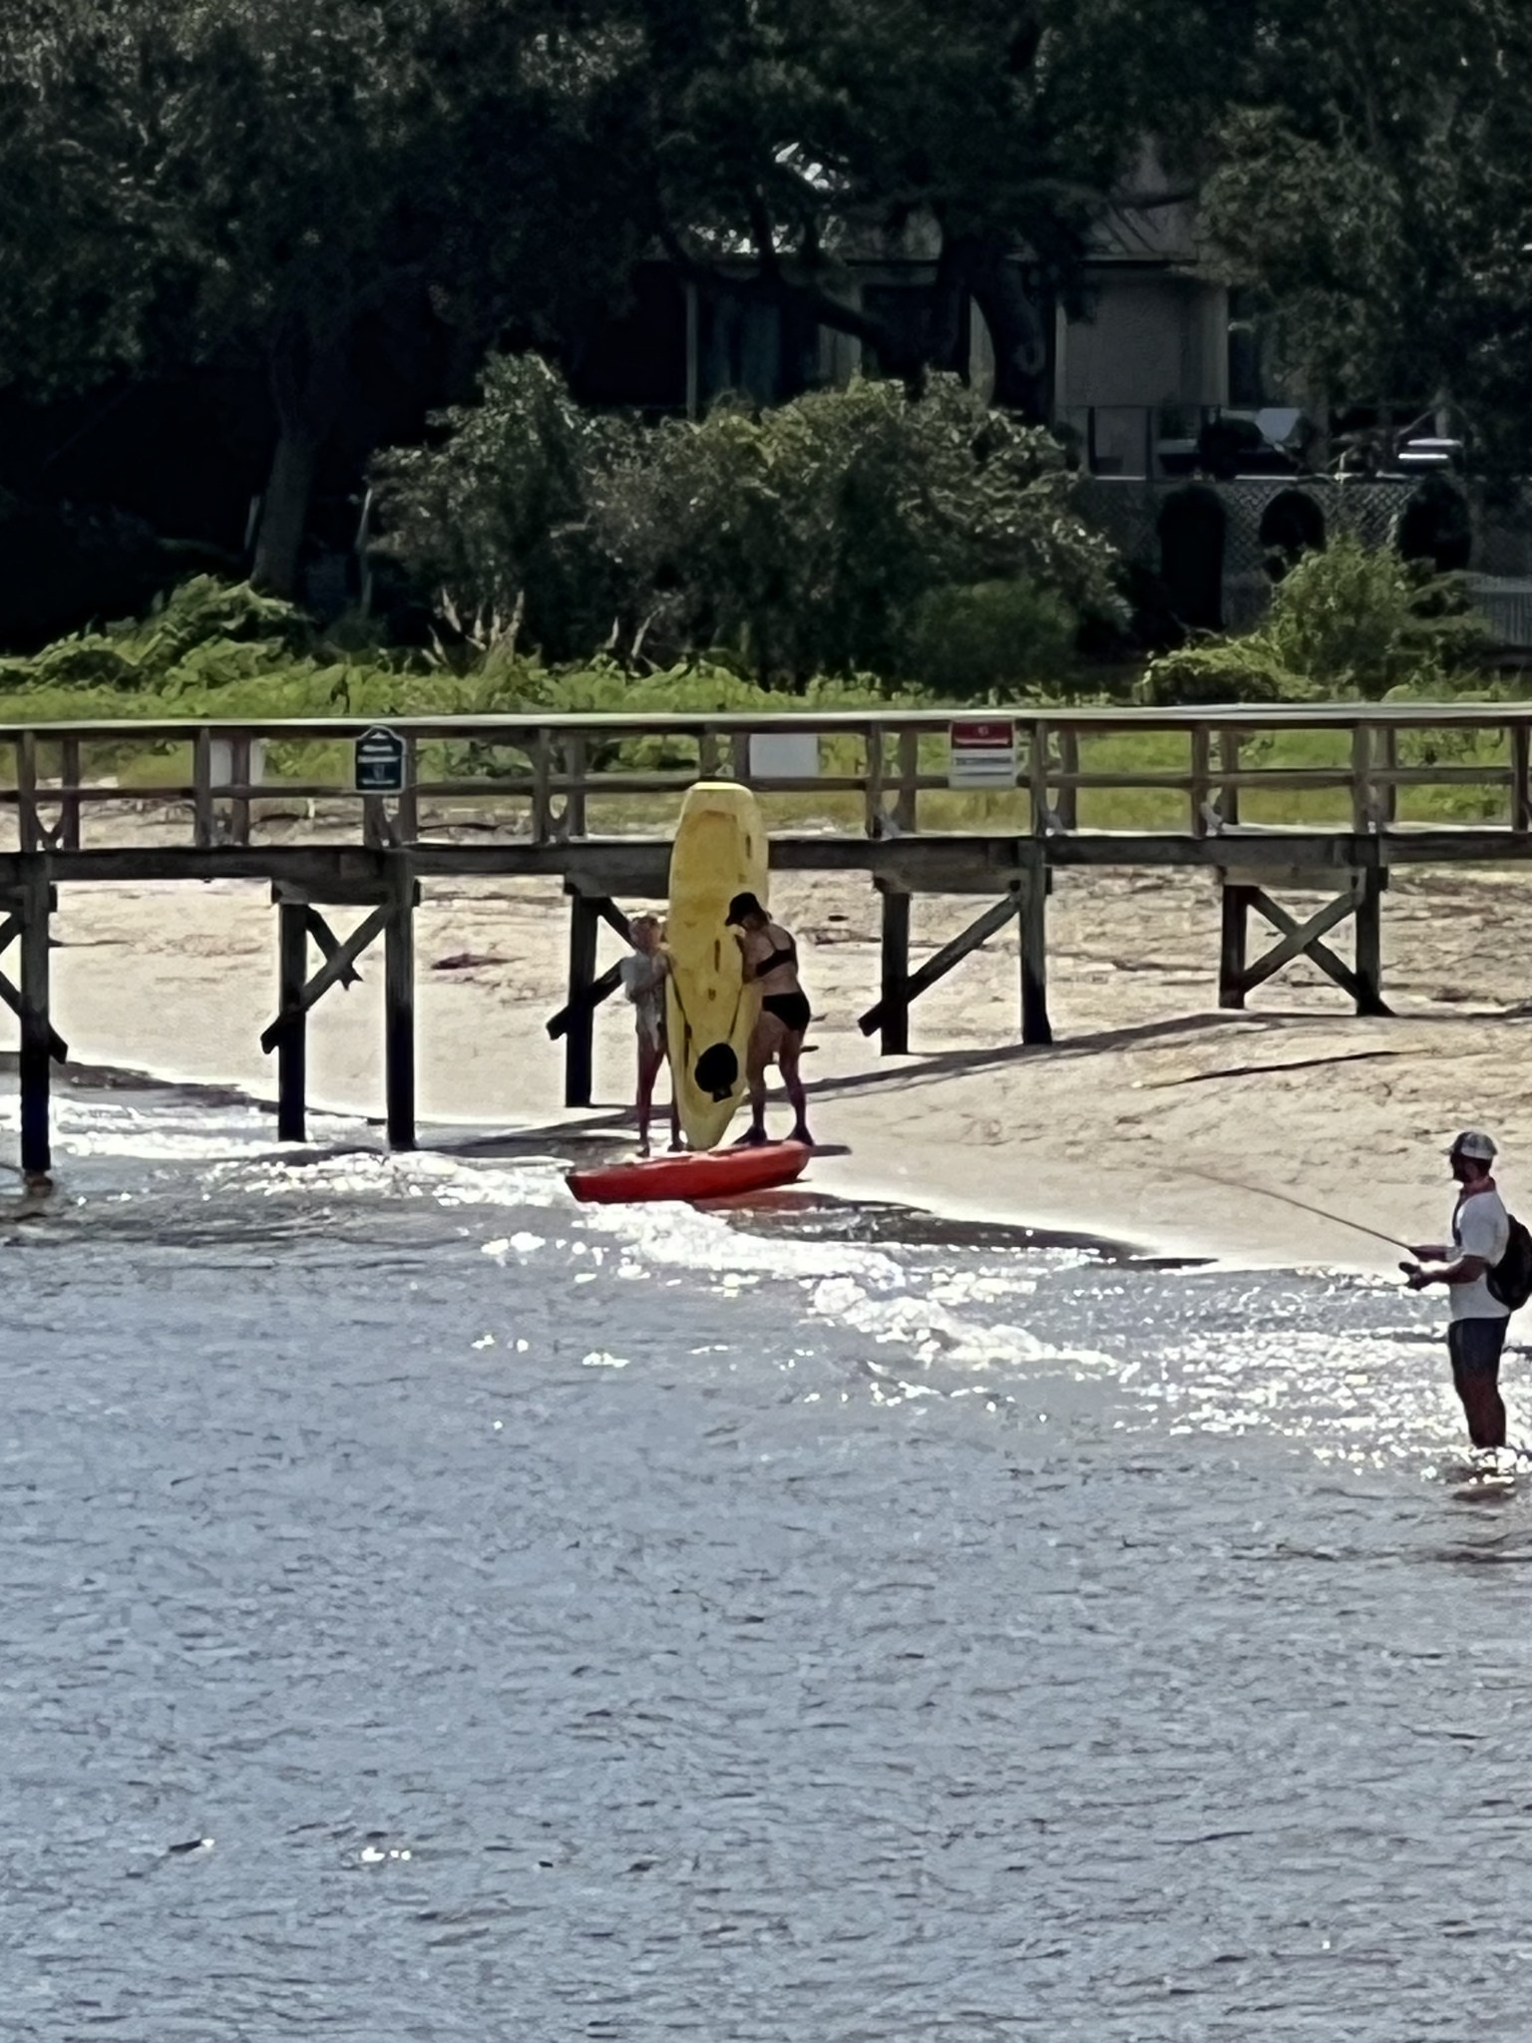
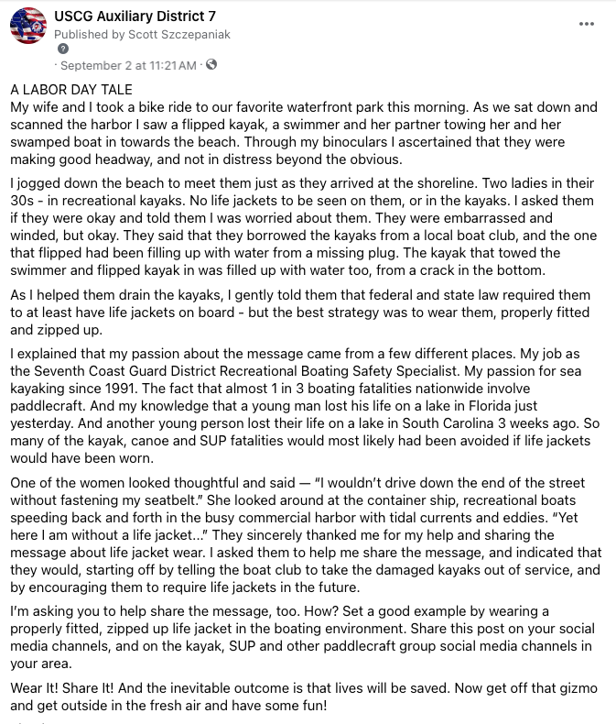

Slide 32
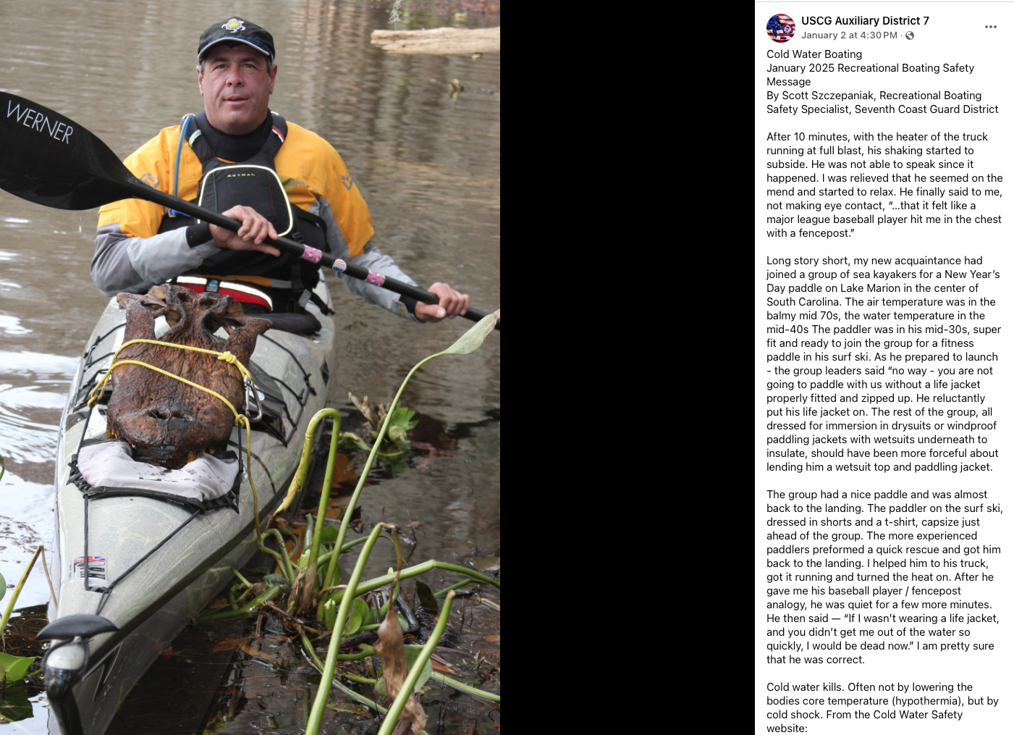

Slide 33
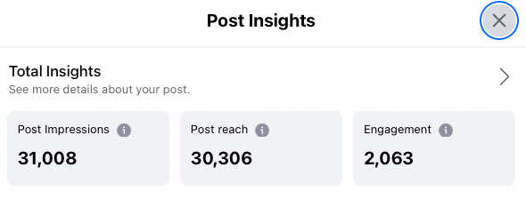
“Meet them where they are!” -Hunter Bland
FACEBOOK GROUPS
UPSTATE KAYAK ANGLERS
SOUTH BEACH COMMUNITY BB
PALMETTO STATE KAYAK FISHING
N. FLORIDA KAYAKERS
GEORGIA KAYAK FISHING COMMUNITY
WHAT’S GOING ON ON ST. THOMAS?
STAND UP PADDLE BOARDS and so on…
“Just because you are posting, doesn't mean you are influencing!” -Scott Szczepaniak

Slide 34
SOCIAL MEDIA INFLUENCERS SECRET RECIPE
JOIN LOCAL / STATE BOATING GROUPS
SHARE “OFFICIAL” POSTS, NEWS STORIES OR RELEVANT MEDIA STORIES
DON’T PREACH
DON’T ARGUE
DO ENGAGE PROFESSIONALLY
CELEBRATE YOUR SUCCESSES!

Slide 35


Slide 36
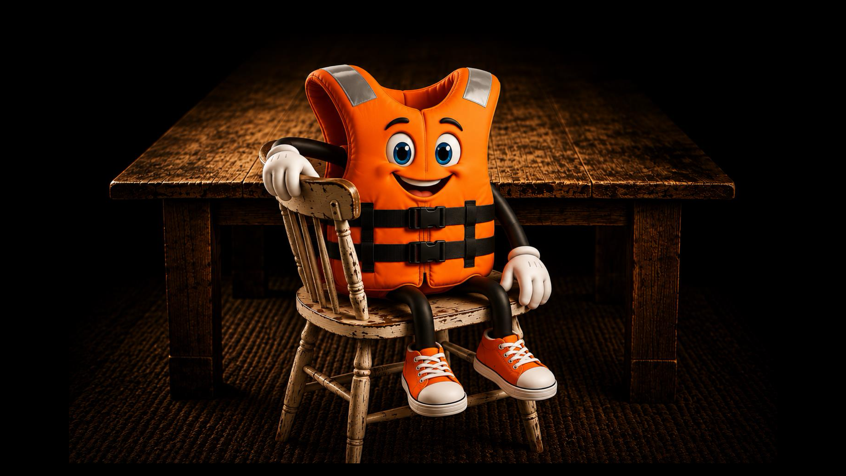

Slide 37

Notes:
START YOUNG - ADVENTURE STARTS BUCKLED BY TOMMY REARDON

Slide 38
BROAD SPECTRUM FEEDBACK
Notes:
MOST IMPORTANT POINT OF TODAY

Slide 39
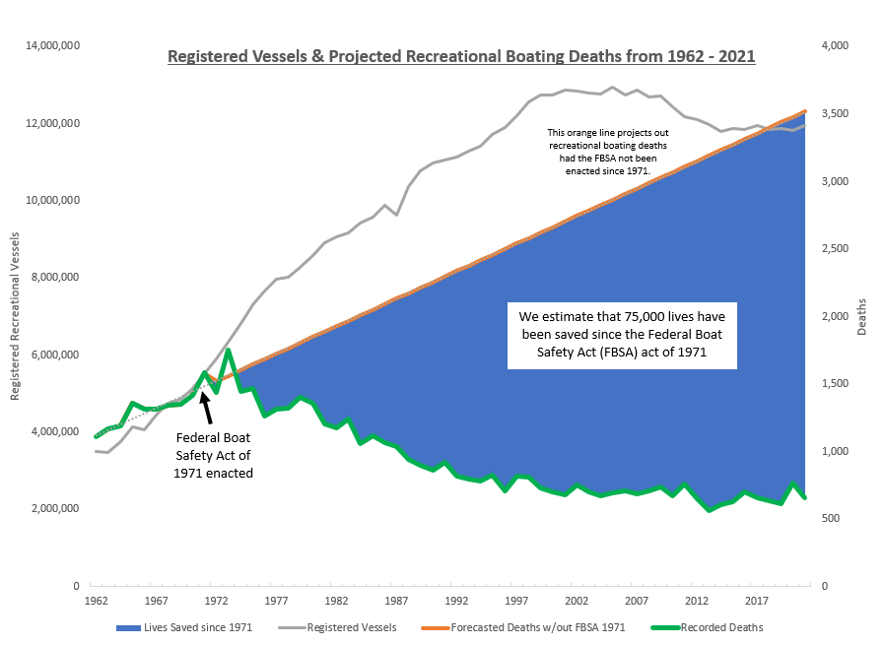
YOU MAKE A DIFFERENCE!
90,000 PLUS LIVES SAVED!
Notes:
FINAL THOUGHT

Slide 40
THANK YOU FOR YOUR TIME AND ENERGY TODAY!
THANK YOU FOR ALL YOU DO TO PROMOTE SAFE BOATING AND SAVE LIVES!
WHAT INITIATIVES WILL YOU EMPLOY TO INFLUENCE PADDLERS BEHAVIORS AND REDUCE FATALITIES?

Slide 41

SCOTT SZCZEPANIAK
RECREATIONAL BOATING SAFETY SPECIALIST
SOUTHEAST COAST GUARD DISTRICT
SCOTT.J.SZCZEPANIAK@USCG.MIL
CELL 843-327-9655
Notes:
MY CONTACT INFO
PLEASE DON’T HESITATE TO REACH OUT - I AM AVAILABLE TO ALL FOR RBS QUESTIONS, CONCERNS, SUPPORT, CONNECTIONS, ANYTHING RELATED TO RBS

